Slide 1

Predicting West Nile Virus in Chicago: A Cost-Benefit Analysis
by Jess Chace, Andy Friedman, Evan Jacobs, and Pete Stafford
Notes:
http://www.wyndhamgrandchicagoriverfront.com/

Slide 2
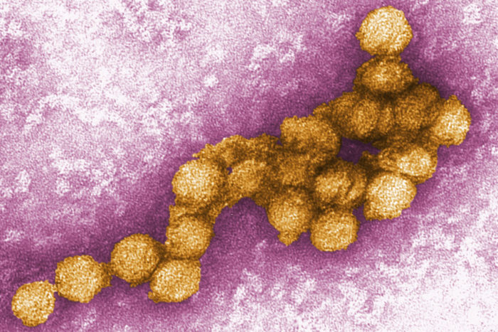
West Nile Virus
Notes:
2 mins total

Slide 3

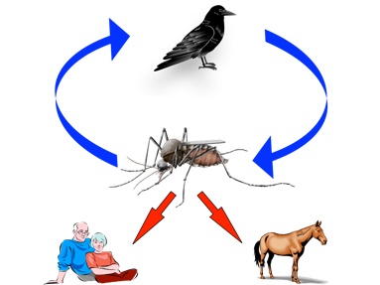
West Nile Virus Overview
West Nile Virus (WNV) was discovered in Uganda in 1937
Spread primarily by female mosquitoes
Affects several bird species and several mammal species, including horses
Causes West Nile fever
75% of cases: no symptoms present
20% of cases: fever, rash, vomiting
1% of cases: encephalitis/meningitis
Chance of death: 1/1500
Notes:
http://www.northwestmvcd.org/Northwestmvcd/West_Nile.html
https://en.wikipedia.org/wiki/West_Nile_fever#/media/File:West_Nile_virus_transmission_cycle.jpg

Slide 4
West Nile and Chicago
First reported case in America: 1999 in Queens, NYC
Total symptomatic cases in America as of October 2017: 47,701
Total deaths: 2108
First case reported in Chicago: 2001
Chicago in 2017:
90 cases
8 deaths
Notes:
http://chicago.cbslocal.com/2018/05/30/west-nile-virus-reported/

Slide 5
The Goal
We seek to create a classification model to predict whether a given mosquito trap is likely to contain a mosquito with WNV.
Additionally, we seek to do a cost benefit analysis on spraying insecticide based on this model.

Slide 6
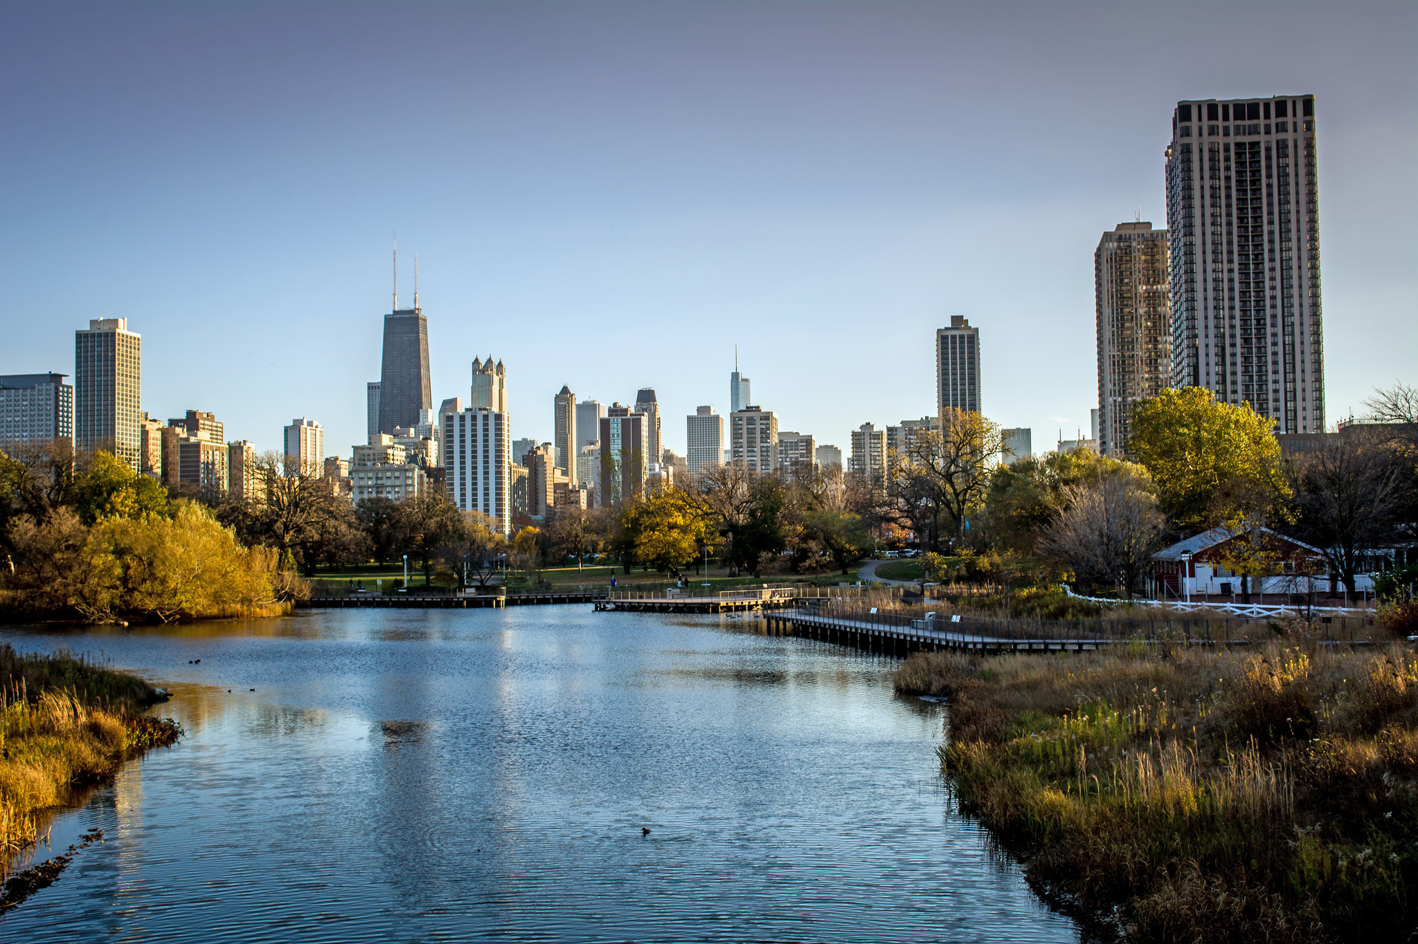
Data Exploration
Notes:
4 mins

Slide 7
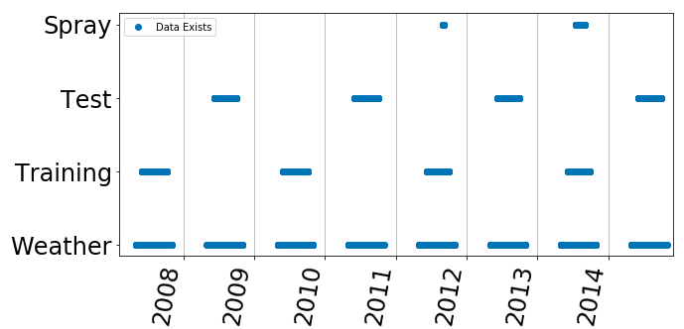
The Data
Our training and testing data covers six month periods from 2007 to 2015, with presence of WNV recorded in the testing data. We have spray data from 2012 and 2014.

Slide 8
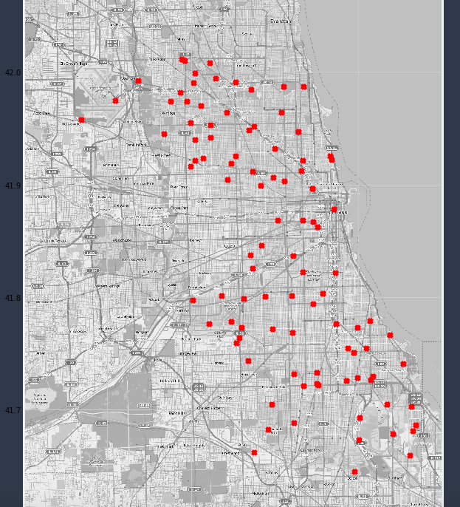
The Map

Slide 9
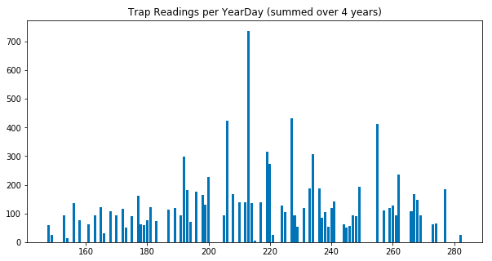
The Mosquitos
Training data had 10506 observations of mosquitoes from 136 traps:
Number of mosquitoes trapped
Species
West Nile.

Slide 10
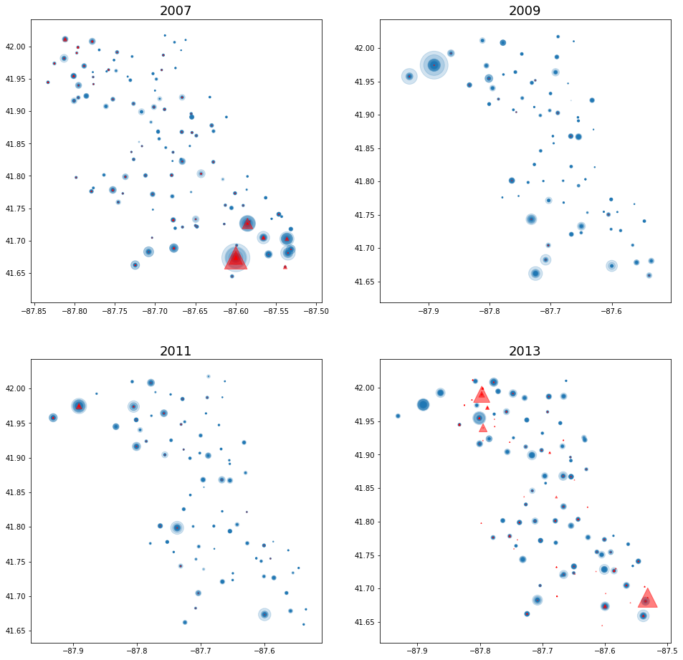
The Mosquitos
Traps covered roughly the same area year over year.

Slide 11
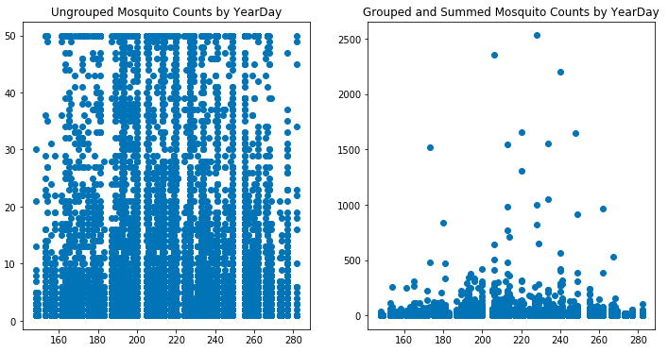
Grouping by Trap
While we were provided timestamps for every observation, we mostly opted to sum the daily data for every trap for our models, as counts were capped at 50 per row.

Slide 12
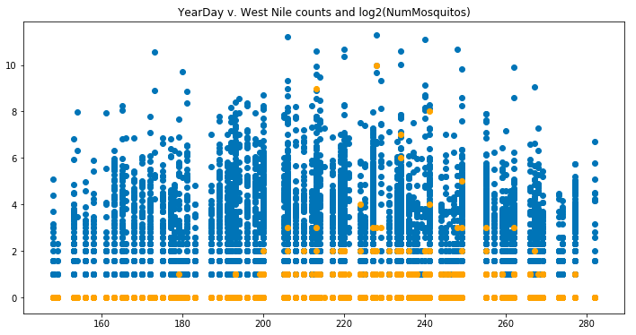
Summing WNV Over Traps
The summed daily data revealed traps where WNV was found as many as 10 times in one day.

Slide 13
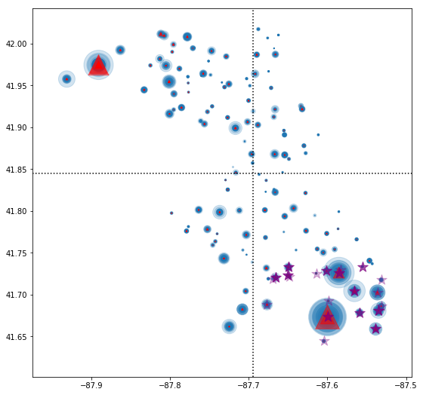
Data Cleaning
Chicago map divided in quadrants:
Created functions to clean data set that, among other things,
Allow summing data by day and trap
Convert date to datetime format, extracts year and day of year
Create dummy columns from object columns
Divide the city into quadrants using the average lat and long

Slide 14
The Weather
Created a function for the weather data that, among other things
Imports weather
Converts date to year and yearday
Uses NLP for “CodeSum” which contain codes for various weather conditions
Removes missing values from “PreciptTotal” and “SnowFall”
Converts 'Sunrise' and 'Sunset' values are converted from four-digit strings to minute of the day values.

Slide 15

Feature Engineering
Notes:
2 Mins

Slide 16
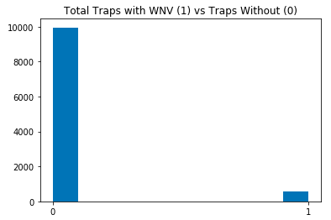
95% Chance of Being Right
Of the 10506 observations in the raw, ungrouped data, only 551, ~ 5%, were positive for WNV.

Slide 17
Balancing Classes
Class weight:
Accuracy: 0.78952
Recall: 0.73275
RandomUnderSampling:
Accuracy: 0.75271
Recall: 0.72413
SMOTE:
Accuracy: 0.79754
Recall: 0.71551

Slide 18
Feature Creation
Clear there was some relationship between location and WNV.
First feature split the city into four quadrants, splitting on the mean of the latitude and longitude.
Second feature calculated a trap's distance from a WNV “hotspot” in the SE corner.
Ultimately, chose model considering whether a trap was within 5 miles of a hotspot.
## The lay of the land
From our initial EDA, it was clear there was some relationship between location and West Nile. In the four years of data, the virus showed a preference for the northwest and southeast parts of the map.
However, lacking the time or resources to translate the geography of the Chicagoland area to latitude and longitude, we instead opted to let the localization of the virus speak for itself by designing two features which considered the distance from the West Nile hot spots.
The first feature simply split the city into four quadrants, with the mean of the latitude and longitude as the boundaries. The second feature calculated a trap's distance from a spot in the southeast corner where West Nile was prevalent. (Ultimately, we opted for a model which considered whether a trap was within 5 miles of the spot in question.)

Slide 19
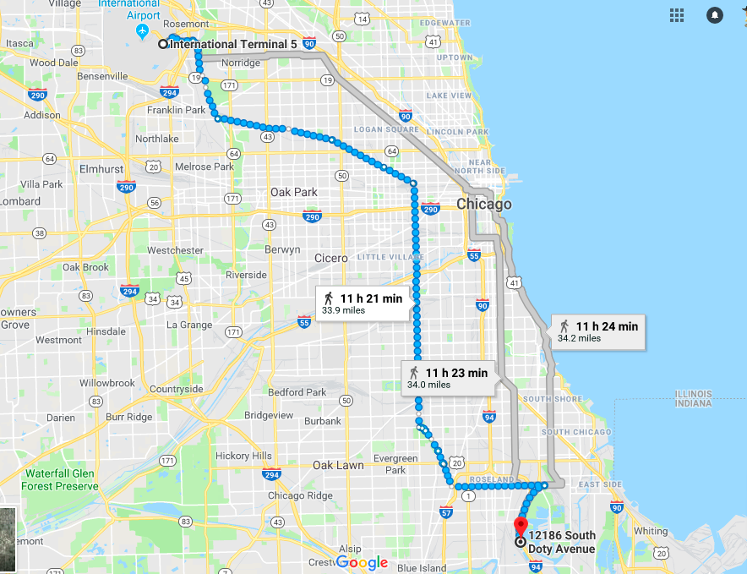
Distance Methodology
2 centroids based on frequency of WNV:
centroid1 = (41.974689, -87.89015)
centroid2 = (41.673408, -87.599862)
Used geopy.distance, vincenty to calculate miles from these two centroids to all other points

Slide 20

Models & Metrics

Slide 21
Accuracy vs. Recall
Instead of accuracy (the percentage of our answers which are right), we looked at recall (sensitivity) to reduce the number of false negatives. That is, we tried to reduce the number of times we misclassified a positive WNV case as a negative.

Slide 22
Models
Tested a variety of techniques Best scores with Random Forest, XGBoost and K-Nearest Neighbors.
Used GridSearch to find and cross-validate optimal parameters.
Random Forest and XGBoost used SMOTE for oversampling, while KNN used SMOTEENN with 'kind_smote' of 'svm'.
All four models pre-scaled the data with Standard Scaler, and the K-Nearest Neighbors model used Select K Best to optimize features.

Slide 23
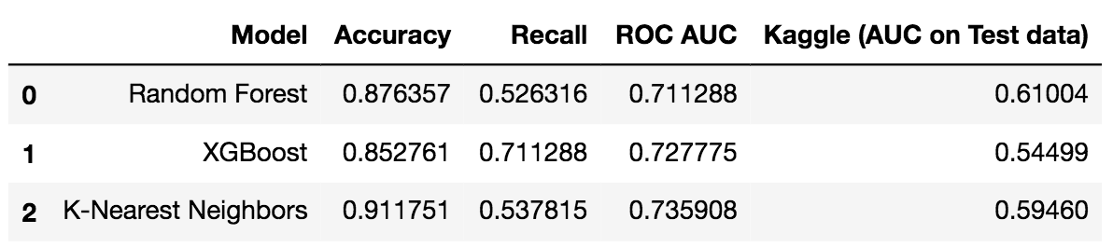
Model Summary

Slide 24

Cost Benefit Analysis

Slide 25
Proxy Data
2002 Proxy data:
NY’s suffolk county budgeded $2.7M for vector control w/ $365K for spraying
Nassau 2002 vector control budget: $1.7M
https://www.nytimes.com/2002/08/11/nyregion/mosquito-control-weighing-costs-versus-benefits.html
2014 CDC study: $778M in health costs and lost productivity.
https://www.sciencedaily.com/releases/2014/02/140210184713.htm

Slide 26
2017 Cost Benefit Analysis of WNV in CA
163 cases
Medical costs: $2.28M
Vector control cost: $701K
Cost benefit analysis: Preventing just 15 cases of severe WNV (neuroinvasive disease) would pay for control cost.
https://www.ncbi.nlm.nih.gov/pubmed/20202424

Slide 27
Chicago 2005 Study
One treatment:
Sprayed in areas of high WNV rates
Significantly decreased mean mosquito density
Mosquito density increased at the non-sprayed sites.
However, other treatments were ineffective, though it was late in the season, and in the end, the study was inconclusive on whether spraying was effective.
https://www.ncbi.nlm.nih.gov/pmc/articles/PMC4230500/

Slide 28
Spraying is Worth it in WNV Hotspots
Reported in Chicago:
2017: 90 cases, 8 deaths
2016: 49 cases, 2 deaths
2015: 16 cases, 3 deaths
Even though our models would benefit from continued development, WNV exists in Chicago, and even minimal spraying in the right areas could reduce the entire number of WNV cases per year. We would advise continuing to spray in areas where and when density of WNV infected mosquitoes is high.

Slide 29

A Plan For Further Research

Slide 30
Real Time Prediction
CO uses a testing kit that provides near real time results for WNV in mosquitoes
Thus we could
predict WNV outbreaks in the near future
Run model weekly or daily based on new results
Real time testing would allow models to be based on fresh data. Features could be built taking this into account.

Slide 31
Possible Features
Positive counts for all dates/location less than current current date.
Positives at a location less than current date.
The status of (positive or negative) of most recent past result at a location.
Positive results in very recent past within a distance threshold from a location.

Slide 32
Results From Other Years
We could create features based on results from other years.
A feature that = -1 for a location/date if it had no positives for WNV in the previous year.
The value would flip to 1 when a date is reached after WNV is positive.
A count of positives for any location before the location/date
Has wnv ever been present at the current location in past years? (0,1)
Has it ever been present at a location within a distance threshold? This would lead to two features – one with distance and one with (0,1) to indicate status.

Slide 33
Comparing Apples to Apples
Many locations have positives in one year and have no positive findings in other years. Why did this happen? What is different in the weather etc between years?
2007 | Pos | 38
2009 | Neg
2013 | Pos | 36
2011 | Neg
2007 | Pos | 29
2011 | Neg
2013 | Pos | 39
2011 | Neg

Slide 34
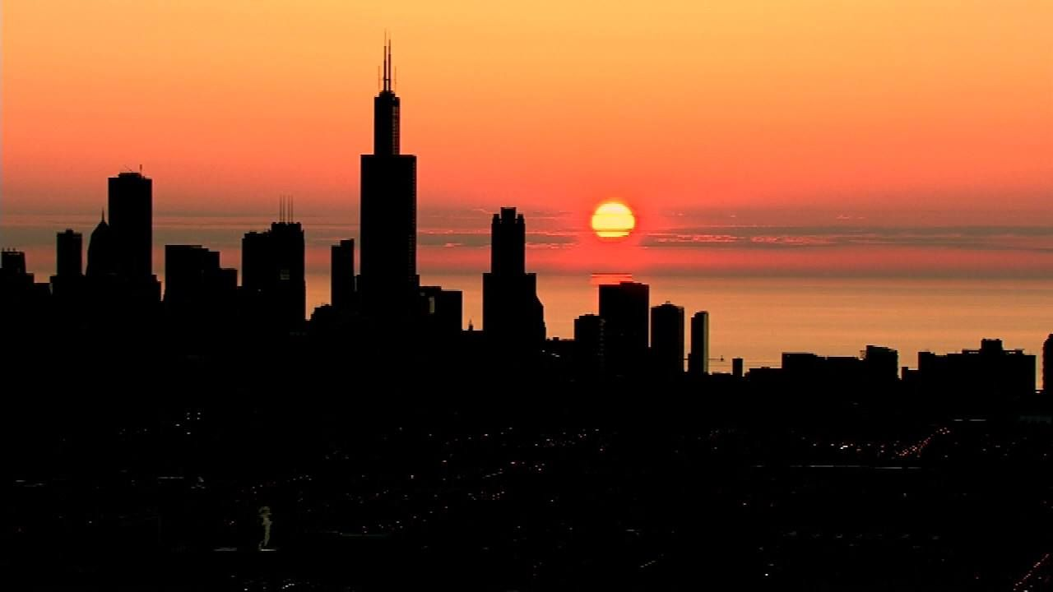
Thank you!

